Slide 1
Loan Defaulter Prediction-Analysis using Machine Learning
By:
Rumana Shaikh

Slide 2
Agenda
Understanding Problem Statement
EDA-Exploring trends in Data Set
Model Building
Hyperparameter Tuning and Model Evaluation
Results & Outcome

Slide 3
Problem Statement
Abstract-Data contains complete loan data for all loans issued , including the current loan status (Current, Late, Fully Paid, etc.), Loanee Information (Demographic data like age, income, Identity proof etc.) Loan Information (Disbursal details, amount, EMI, loan to value ratio etc.) Bureau data & history (Bureau score, number of active accounts, the status of other loans, credit history etc.) Doing so will ensure that clients capable of repayment are not rejected and important determinants can be identified which can be further used for minimising the default rates.
Goal- Our goal here is to predict potential loan defaulters. (variable y).

Slide 4
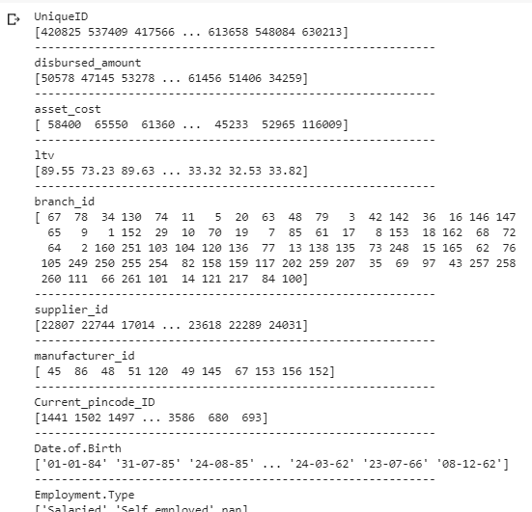
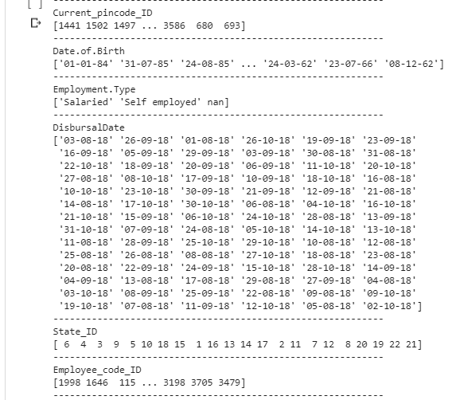
EDA
Dataset with 41 features for 233154 clients with binary target variable 1/0.
Understanding the trends & correlation among each features.
Name: loan_default count-
0 : 182543 1: 50611

Slide 5
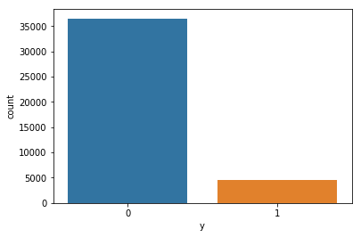
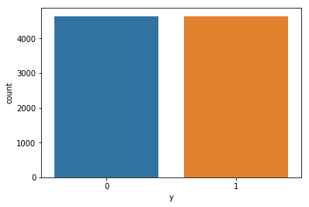
Data Imbalance Count Plot Under sampling
BEFORE
AFTER

Slide 6
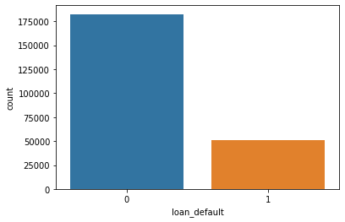
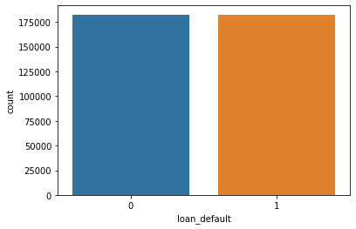
Features Comparison
Over Sampling
After under sampling I moved to over sampling for getting better results
Before Over Sampling After Over Sampling

Slide 7
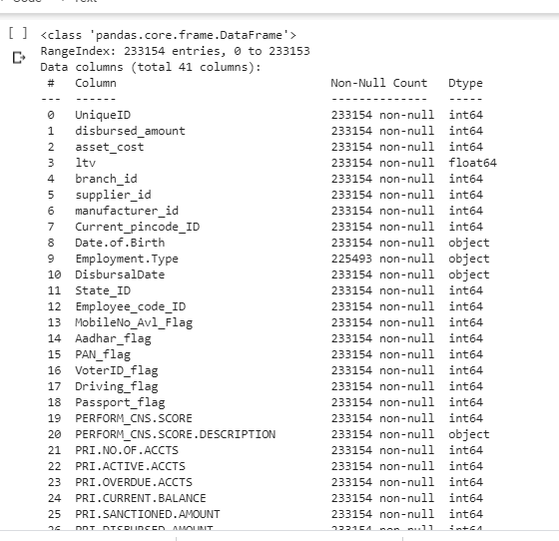
Handling the missing values and Data Preparation
Column Employment type had many missing values addressed as nan hence we filled it with the mode
Also it got encoded Salaried': 1, 'Self employed': 0}
We Calculated Age from Date of Birth, DisbursalDate column and replaced it wit the no of years.
Columns AVERAGE_ACCT_AGE and CREDIT.HISTORY.LENGTH were containing Date in the format of “3 yrs 6mon “ changed to 3.5 years and so on.

Slide 8
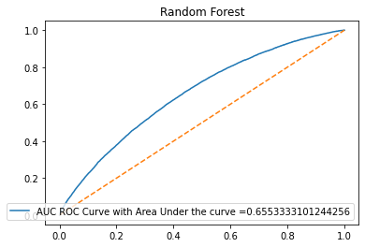
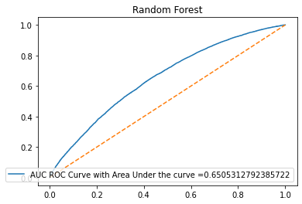
Random Forest Classifier
AUC ROC Curve-Imbalanced Data set
AUC ROC Curve-Balanced Data set with under sampling

Slide 9
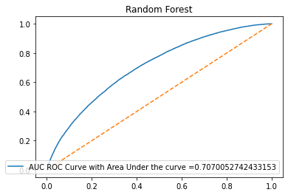
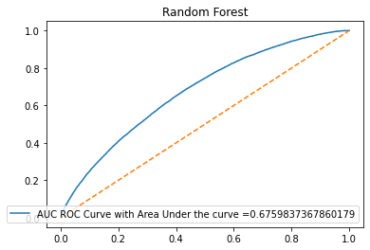
Random Forests with Over Sampling
AUC ROC Curve-balanced Data set
Oversampling
AUC ROC Curve Hyperparameter tuning Data set

Slide 10
Comparison Chart for our models

Slide 11
Training Vs Testing Score

Slide 12
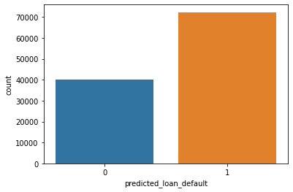
Final Test Prediction
0:40138 values 1:72254 values

Slide 13
Thankyou

